Slide 1
Digital Design of Error-Correcting SPI Communication
Jon Case
Travis Davison

Slide 2
Design Specifications
1 master connected to an external processor
2 slaves connected to external peripheral devices
Messages sent between processor and peripheral devices should take 48 clock cycles
16 clock cycles / packet processed
Hamming encode
Transmit serially
Hamming decode
Each message will be encoded in a 2-byte packet
11 bits for the message
4 parity bits for 1-bit error correction
1 parity bit for 2-bit error detection

Slide 3
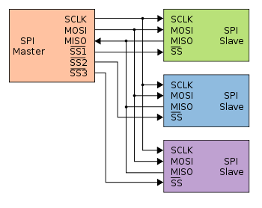
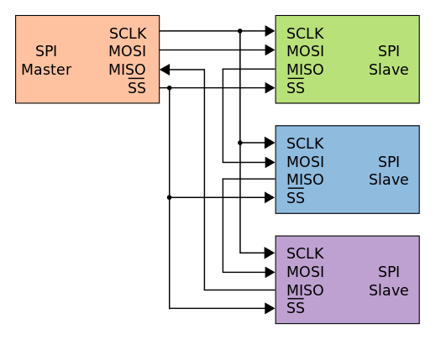
SPI Communication
Synchronous serial communication interface
Master controls clock and slave-select line
Configurations
Independent slave (our choice)
Daisy chain
Benefits
Full-duplex
High transfer speed
Low power
Downsides
No error detection/correction
Shorter transfer distances
Different variants lead to compatibility issues
Independent Slave
Daisy chain

Slide 4
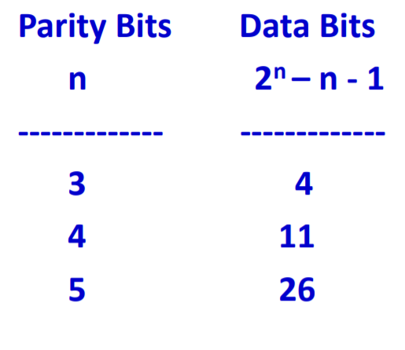
Hamming Codes
A parity bit allows for error detection
Multiple parity bits allow for error correction
The amount of data that can be encoded increases exponentially with the amount of parity bits
 |  |  | d₁₀
 | d₉ | d₈ | d₇
 | d₆ | d₅ | d₄
d₃ | d₂ | d₁ | d₀

Slide 5
Hamming Codes
A parity bit allows for error detection
Multiple parity bits allow for error correction
The amount of data that can be encoded increases exponentially with the amount of parity bits
 | p₃ | p₂ | d₁₀
p₁ | d₉ | d₈ | d₇
p₀ | d₆ | d₅ | d₄
d₃ | d₂ | d₁ | d₀

Slide 6
Hamming Codes
A parity bit allows for error detection
Multiple parity bits allow for error correction
The amount of data that can be encoded increases exponentially with the amount of parity bits
 |  |  | 1
 | 0 | 1 | 0
 | 1 | 0 | 0
0 | 0 | 1 | 1

Slide 7
Hamming Codes
A parity bit allows for error detection
Multiple parity bits allow for error correction
The amount of data that can be encoded increases exponentially with the amount of parity bits
 | 1 |  | 1
 | 0 | 1 | 0
 | 1 | 0 | 0
0 | 0 | 1 | 1

Slide 8
Hamming Codes
A parity bit allows for error detection
Multiple parity bits allow for error correction
The amount of data that can be encoded increases exponentially with the amount of parity bits
 | 1 | 0 | 1
 | 0 | 1 | 0
 | 1 | 0 | 0
0 | 0 | 1 | 1

Slide 9
Hamming Codes
A parity bit allows for error detection
Multiple parity bits allow for error correction
The amount of data that can be encoded increases exponentially with the amount of parity bits
 | 1 | 0 | 1
1 | 0 | 1 | 0
 | 1 | 0 | 0
0 | 0 | 1 | 1

Slide 10
Hamming Codes
A parity bit allows for error detection
Multiple parity bits allow for error correction
The amount of data that can be encoded increases exponentially with the amount of parity bits
 | 1 | 0 | 1
1 | 0 | 1 | 0
1 | 1 | 0 | 0
0 | 0 | 1 | 1

Slide 11
Hamming Codes
A parity bit allows for error detection
Multiple parity bits allow for error correction
The amount of data that can be encoded increases exponentially with the amount of parity bits
 | 1 | 0 | 1
1 | 0 | 1 | 0
1 | 1 | 0 | 0
0 | 0 | 1 | 1

Slide 12
Hamming Codes
A parity bit allows for error detection
Multiple parity bits allow for error correction
The amount of data that can be encoded increases exponentially with the amount of parity bits
? | 1 | 0 | 1
1 | 0 | 1 | 0
1 | 1 | 0 | 0
0 | 0 | 1 | 1

Slide 13
Hamming Codes
A parity bit allows for error detection
Multiple parity bits allow for error correction
The amount of data that can be encoded increases exponentially with the amount of parity bits
0 | 1 | 0 | 1
1 | 0 | 1 | 0
1 | 1 | 0 | 0
0 | 0 | 1 | 1

Slide 14
Hamming Codes
A parity bit allows for error detection
Multiple parity bits allow for error correction
The amount of data that can be encoded increases exponentially with the amount of parity bits
p₄ | p₃ | p₂ | d₁₀
p₁ | d₉ | d₈ | d₇
p₀ | d₆ | d₅ | d₄
d₃ | d₂ | d₁ | d₀

Slide 15
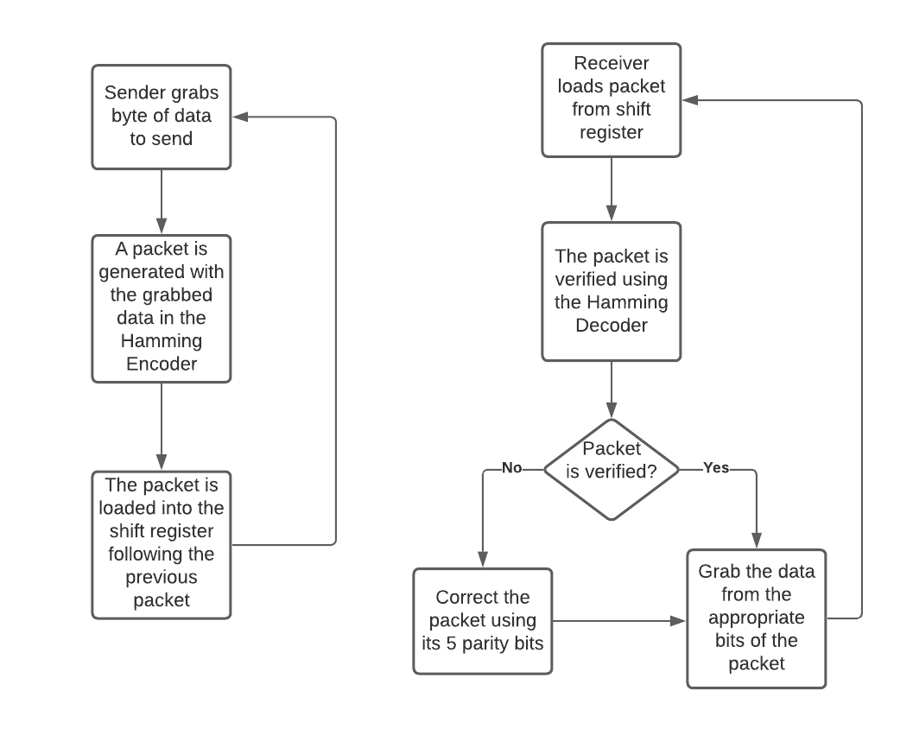
Design - Data Transfer Process

Slide 16
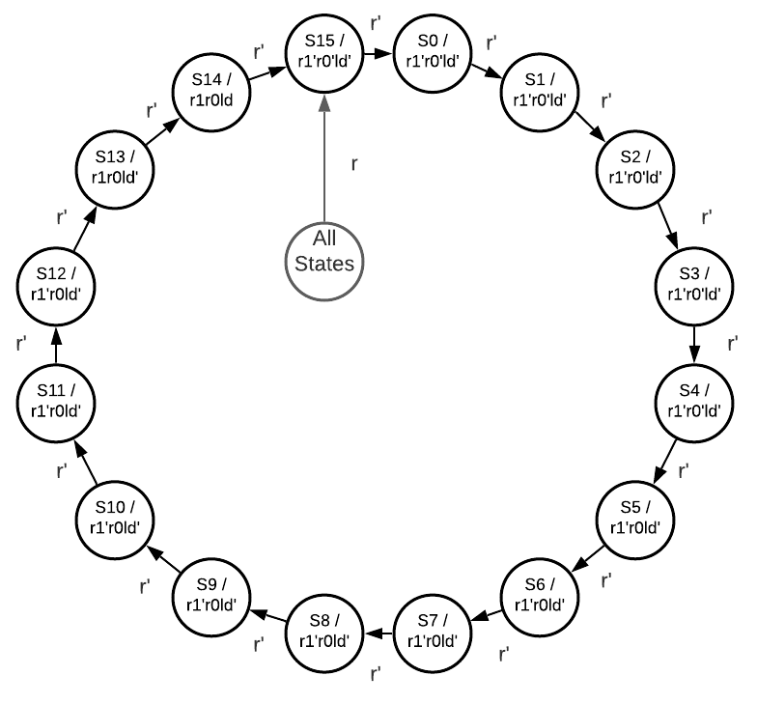
Design - Encoding Process Iterator
S0-S6: Row/Col Parity Bit
S7-S14: Entire Parity Bit
S15: Load into Parallel-Serial Converter
r: input reset
r1: reset entire parity state
r0: reset row/col parity state
ld: load

Slide 17
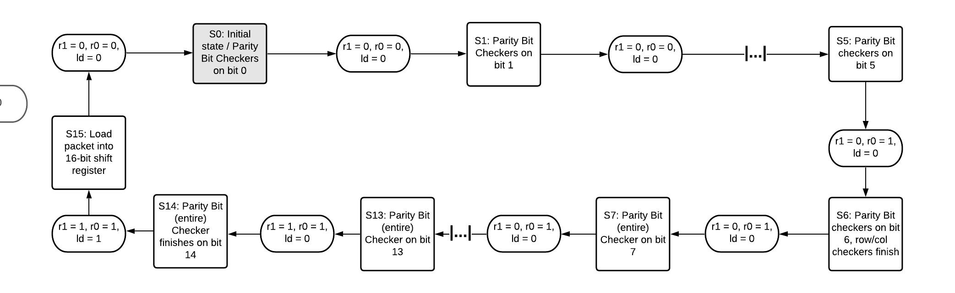
Design - Encoding Process Iterator

Slide 18
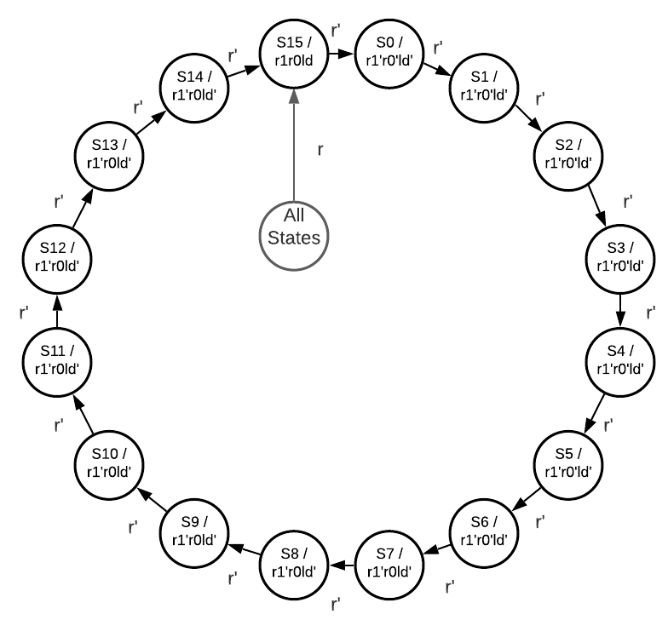
Design - Decoding Process Iterator
S0: Entire Parity Bit / Load out of Serial-Parallel Converter
S1-S8: Row/Col Parity Bit
S9-S15: Entire Parity Bit
r: input reset
r1: reset entire parity state
r0: reset row/col parity state
ld: load

Slide 19
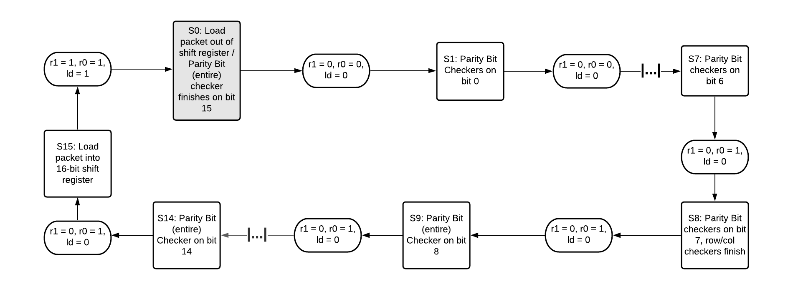
Design - Decoding Process Iterator

Slide 20
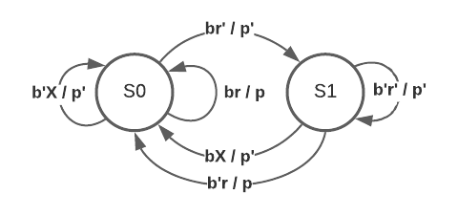
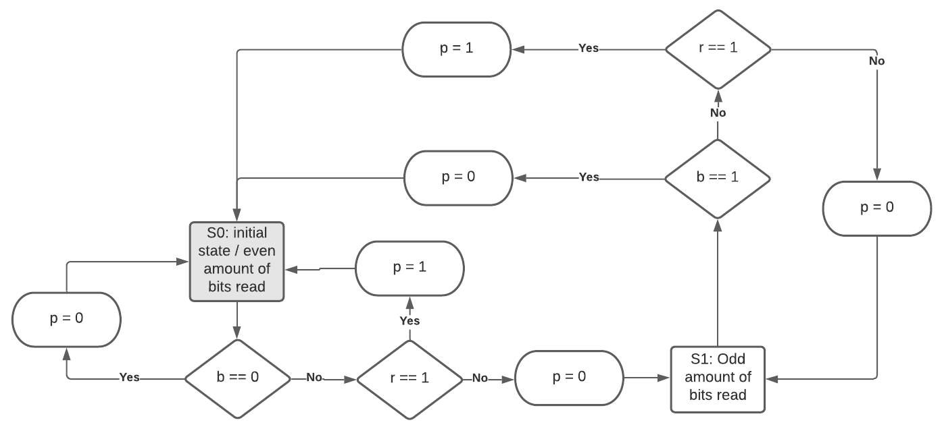
Design - Even Parity Detector
S0: Even amount of 1s
S1: Odd amount of 1s
b: currently selected bit in data
r: reset
p: output parity bit to be generated / flag for incorrect parity

Slide 21
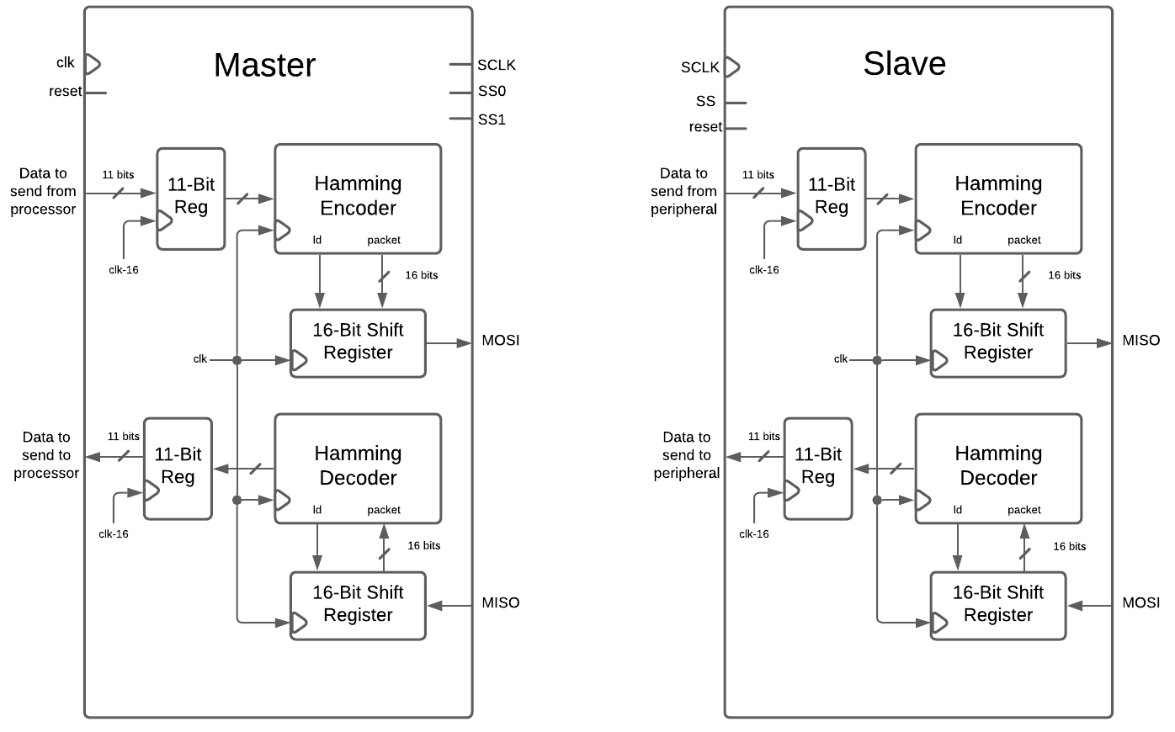
Design - Master/Slave (Top Level)
Both devices
2 11-bit registers
Hamming encoder
5 even parity detectors
Hamming decoder
5 even parity detectors
16-bit SIPO shift register
16-bit PISO shift register
Clock input
Master
Clock output (to synch with slaves)
2 slave select line outputs
Slave
Slave select line input

Slide 22
Implementation - Verilog
Module Hierarchy
Top
Master
Hamming encoder
5 even parity detectors
Hamming decoder
5 even parity detectors
16-bit SIPO shift register
16-bit PISO shift register
2 Slaves
Hamming encoder
5 even parity detectors
Hamming decoder
5 even parity detectors
16-bit SIPO shift register
16-bit PISO shift register

Slide 23
Implementation - Demo
ModelSim Waveform

Slide 24
Synthesis Analysis
Timing
Slack for 10ns clock: 3.7ns
Slack for 1.08ns clock: 0.0 (no violation occurred)
Clock: 1.1ns
Area
Combinational Area: 728.308006
Buf/Inv area: 59.850000
Noncombinational area: 1497.047961
Total Cell Area: 2225.355968
Power (operating at 1.25V)
Internal: 2.2543 mW
Switching: 590.3713 uW
Total: 2.9939 mW

Slide 25
Conclusion
This project helped strengthen our experience in digital logic design and Verilog HDL
The initial design for the Encoding/Decoding Process Iterators were incorrect
The generated outputs were 1 cycle ahead
We had to redesign after testing in verilog
Not only did we gain more experience in synthesis, but we also got to see how it can point out design issues that Verilog HDL will not show in compilation nor simulation
An unwanted latch was generated during synthesis which helped us figure out that our design was realized incorrectly in a case statement

Slide 26


Presenters
Jon Case
Travis Davison
Digital logic design
Verilog implementation
Testbench/simulation
Digital logic design
Verilog implementation
Synthesis

